Slide 1
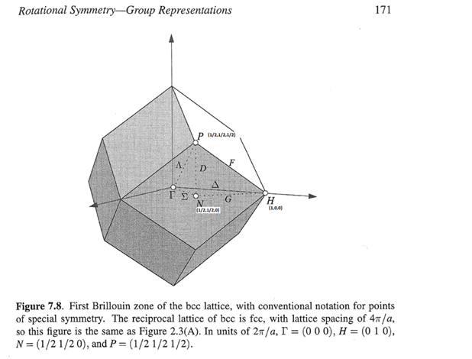
GP
w2nbg = cut(src800sym3,line_proj,0.04,0.04,[-0.1,0.1],[95,105])

Slide 2
GP 800 meV

Slide 3
GP 1400meV

